Slide 1
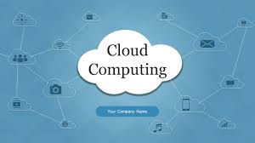
Title: AWS Infrastructure Automation with Terraform & CloudFormation Subtitle: PROG 8870 – Final Project Name: Durlabh Tilavat (ID: 8938972)

Slide 2
Agenda
Project Objectives
Tools & Technologies
Architecture Diagram
Terraform Implementation
CloudFormation Implementation
GitHub Repository
Demo Walkthrough
Challenges & Solutions
Security Best Practices
Conclusion

Slide 3
Project Objectives
Build secure and scalable AWS infrastructure
Automate provisioning with Terraform & CloudFormation
Implement modular Infrastructure as Code (IaC)
Ensure reusability, security, and best practices

Slide 4

Tools & Technologies
Terraform – Automating AWS infrastructure creation
CloudFormation – AWS-native infrastructure provisioning
AWS Free Tier – Hosting infrastructure
GitHub – Version control and collaboration
IaC Benefits: Reusability, versioning, automation, consistency

Slide 5
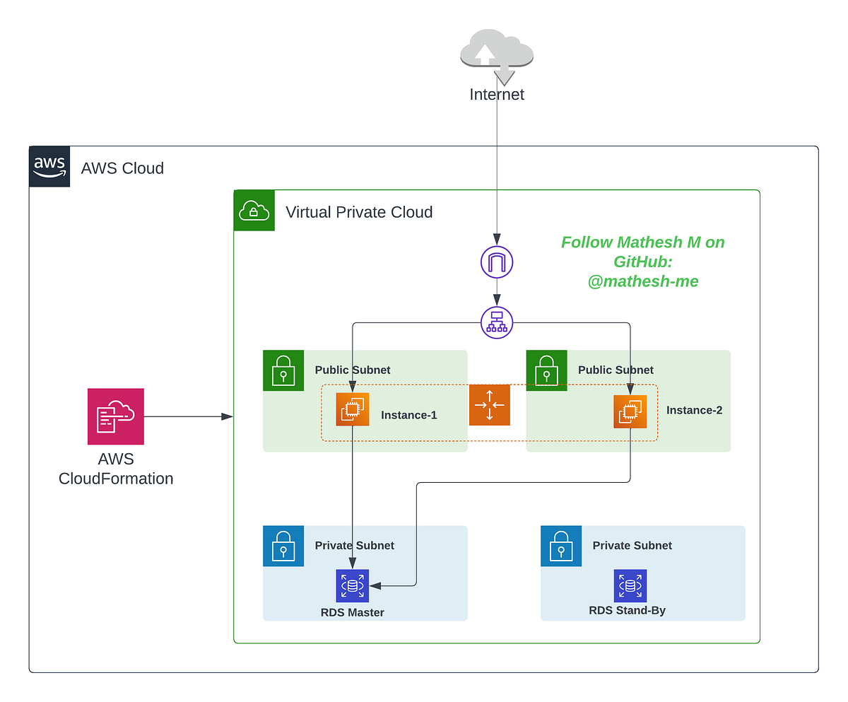
Architecture Diagram
Custom AWS architecture diagram showing:
VPC
Public Subnet
Route Table + IGW
EC2 Instance
Security Group

Slide 6
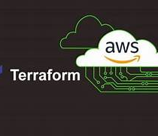
Terraform Implementation
Files Used: main.tf, variables.tf, outputs.tf
VPC creation with CIDR blocks
Public & private subnets in multiple AZs
EC2 instance with security group
S3 backend for Terraform state management

Slide 7

CloudFormation Implementation
YAML templates for:
EC2 instance (reusing VPC from Terraform)
RDS database (multi-AZ, private subnet)
Parameters for flexibility
Stack creation via AWS Console
This Photo by Unknown Author is licensed under CC BY-SA-NC

Slide 8
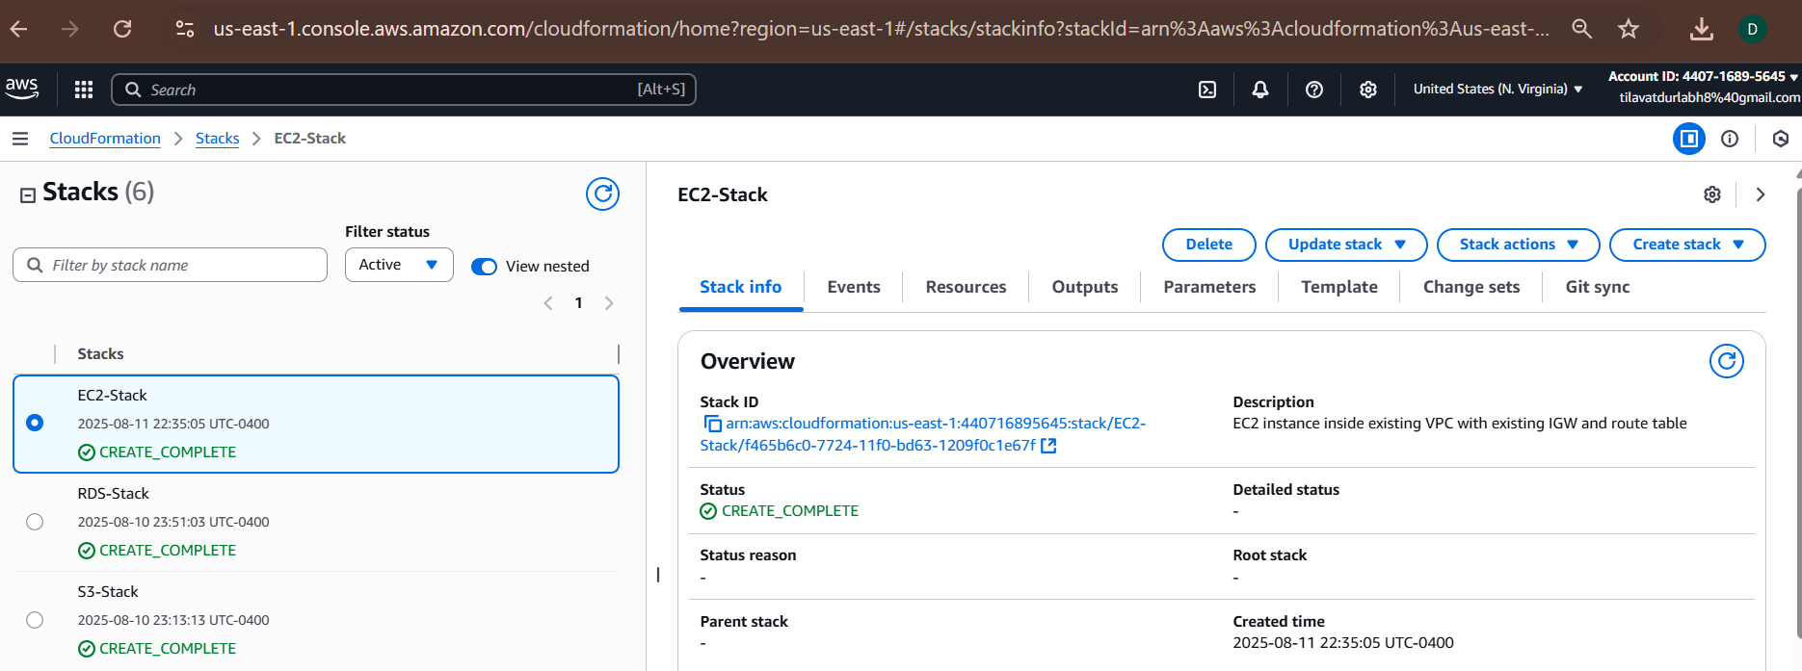
Deployment
Screenshot of CloudFormation stack creation.

Slide 9
Challenges & Solutions
Challenge | Solution
Missing key pair | Created new key in AWS console & updated YAML
Wrong subnet settings | Used correct VPC & subnet ID
Stack rollback | Corrected IAM permissions

Slide 10
Security Best Practices
Private subnet for database
SSH access restricted by IP
S3 public access blocked
Security groups with least privilege

Slide 11
Conclusion & Learning
Learned automation of infrastructure using IaC.
Understood networking components in AWS.
Gained hands-on experience with troubleshooting AWS errors.

